Slide 1
LABOR CONNECT
Submitted in the partial fulfillment for the award of the degree of
BACHELOR OF ENGINEERING
IN
INFORMATION SECURTIY
Submitted by:
Yuvraj Singh 20BCS3527
Aditya Sharma 20BCS3512
Under the Supervision of:
Prof. Neha Sharma
Department of AIT-CSE
DISCOVER . LEARN . EMPOWER

Slide 2
Outline
Introduction to Project
Problem Formulation
Objectives of the work
Methodology used
Results and Outputs
Conclusion
Future Scope
References

Slide 3
Introduction to Project
In response to the limitations of the traditional labor chowks system, "Digital Labor Connect" is a pioneering solution designed to tackle the challenges faced by both workers and employers
"Digital Labor Connect" comprises a dynamic mobile application and a web admin tool.
The mobile app allows workers to create comprehensive profiles, explore diverse job opportunities, and apply directly from their devices.

Slide 4
Problem Formulation
The traditional labor chowks system lacks efficiency and transparency, making it challenging for workers and employers in the construction industry to connect seamlessly.
The current system makes unemployment and underemployment worse
This means many job opportunities are missed because people can't easily find each other or get the needed information.

Slide 5
Objectives of the Work
Efficient Labor Matching: To create a user-friendly platform that efficiently matches job seekers with suitable employment opportunities
Enhanced Accessibility: To increase accessibility to job opportunities by utilizing technology, enabling job seekers to easily find and apply for relevant positions
Simplified Management: To provide employers with a straightforward web admin tool for posting jobs, managing applications, and selecting suitable candidates, streamlining the hiring process.

Slide 6
Methodology used
Requirement Analysis: Conduct a thorough analysis of the requirements from both workers and employers. Understand their needs, pain points, and expectations to shape the features and functionalities of the platform.
Technology Selection: Choose appropriate technologies for both the mobile application and web admin tool, considering factors such as platform compatibility, scalability, and integration capabilities.
Mobile App Development: Develop the mobile application using modern app development frameworks and tools.

Slide 7
Methodology used
Web Admin Tool Development: Create the web admin tool with features such as job posting management, worker profile viewing, application tracking, and real-time analytics.

Slide 8
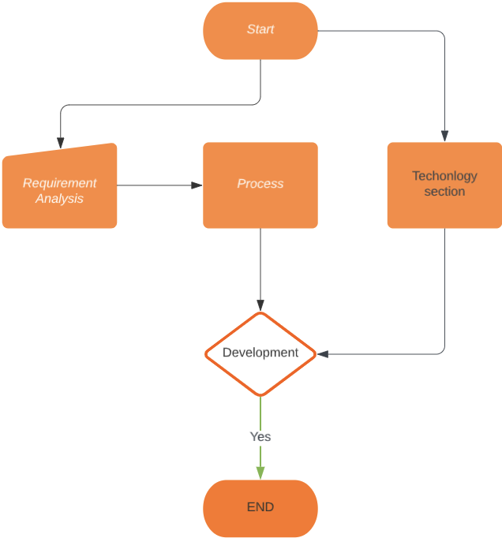
FLOWCHART

Slide 9
Conclusion
The Digital Labor Connect project aims to address the challenges faced by workers and employers in the traditional labor chowks system.
By developing a mobile application and web admin tool, we have created a platform that connects workers and employers, making it easier for them to find each other and work together
The platform provides transparency, efficiency, and accessibility, benefiting both workers and employers. Future enhancements could include expanding the platform to other industries and incorporating additional features based on user feedback.

Slide 10
Future Scope
Diversification: The platform's model can be adapted to connect workers and employers in other industries beyond construction, such as manufacturing, hospitality, healthcare, and more.
Geographical Expansion: After achieving a strong presence in a specific region, the platform can expand its reach to cover a broader geographic area, connecting workers and employers from different cities or countries.

Slide 11
References
[1] The Busy Coder's Guide to Android Development by Mark L.Murphy
View at: Publisher Site | Google Scholar
[2] Web Development: Estimating Quick-to-Market Software by Donald J. Reifer
View at: Publisher Site | Google Scholar

